Slide 1
Neural Network
Ying SHEN
Sse, tongji university
Dec. 2016

Slide 2
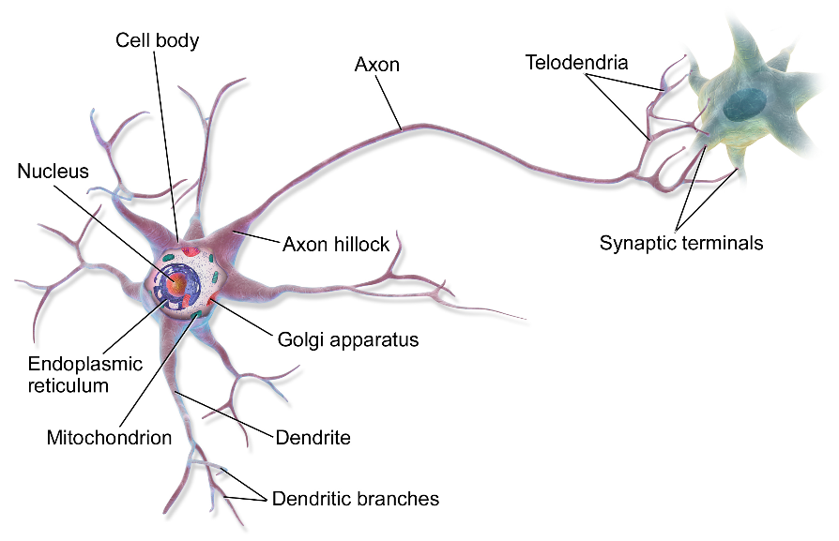
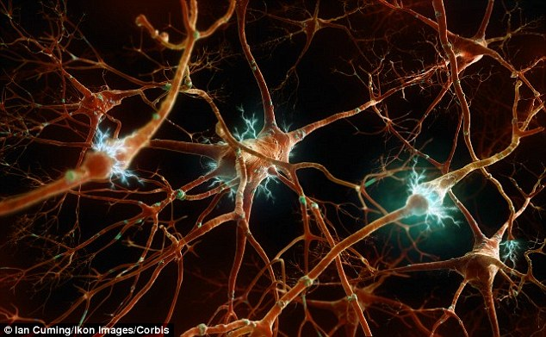
Neural Network
The study of artificial neural networks was inspired by attempts to simulate biological neural systems.
The human brain consists primarily of nerve cells called neurons.
They are linked together with other neurons via strands of fiber called axons.
Axons are used to transmit nerve impulses from one neuron to another whenever the neurons are stimulated.
Notes:
Axon 轴突

Slide 3
Neural Network
A neuron is connected to the axons of other neurons via dendrites, which are extensions from the cell body of the neuron.
The contact point between a dendrite and an axon is called a synapse.
The human brain learns by changing the strength of the synaptic connection between neurons upon repeated stimulation by the same impulse.
Notes:
Dendrite 树突
Synapse 突触

Slide 4
Artificial neuron
The unit of computation in neural networks is the artificial neuron.
An artificial neuron consists of
  Input signals
  A set of real-valued weights
  An activation level
  A threshold function

Slide 5
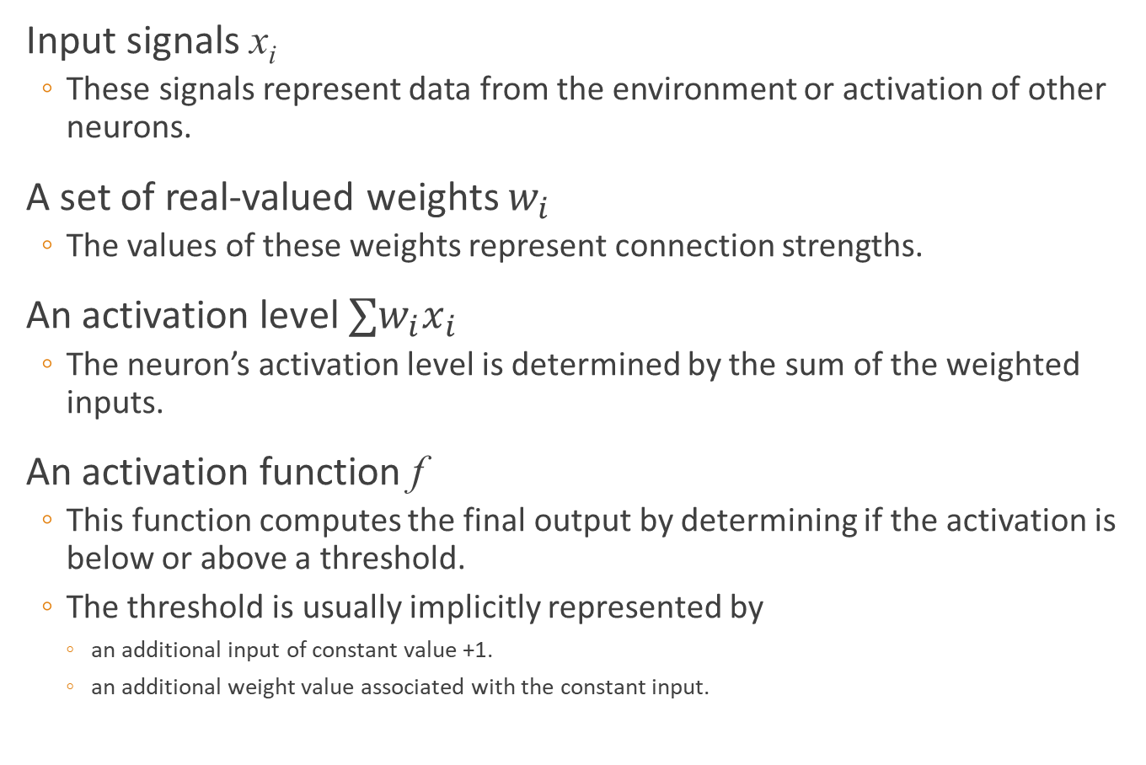
Artificial neuron
Input signals x_{i}
  These signals represent data from the environment or activation of other neurons.
A set of real-valued weights $w_{i}$
  The values of these weights represent connection strengths.
An activation level $∑w_{i}x_{i}$
  The neuron’s activation level is determined by the sum of the weighted inputs.
An activation function f
  This function computes the final output by determining if the activation is below or above a threshold.
  The threshold is usually implicitly represented by
    an additional input of constant value +1.
    an additional weight value associated with the constant input.

Slide 6





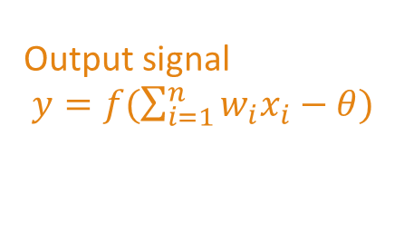

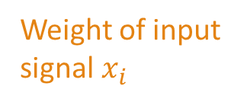








Artificial neuron
Given the activation value $net=∑w_{i}x_{i}−θ_{j}$, the output of the neuron is given by
$$f\left(net\right)=\left\{\begin{matrix}1 & if ∑w_{i}x_{i}−θ_{j}≥0 \\ 0 & if ∑w_{i}x_{i}−θ_{j}<0\end{matrix}\right.$$
Input signal from i-th neuron
A neuron
$$x_{1}$$
Output signal
$y=f(\sum_{i=1}^{n}{w_{i}x_{i}}−θ)$
$$w_{1}$$
$$x_{2}$$
$$w_{2}$$
$$y$$
$$⋮$$
$$⋮$$
$$θ$$
$$w_{i}$$
$$x_{i}$$
$$⋮$$
A threshold
$$w_{n}$$
$$x_{n}$$
Weight of input signal $x_{i}$

Slide 7
Example
An artificial neuron can be used to compute the logic AND function.
The neuron has three inputs
  x and y are the original inputs.
  The third is the bias input which has a constant value of +1.
The input data and bias have weights of +1, +1, and –2 respectively.

Slide 8
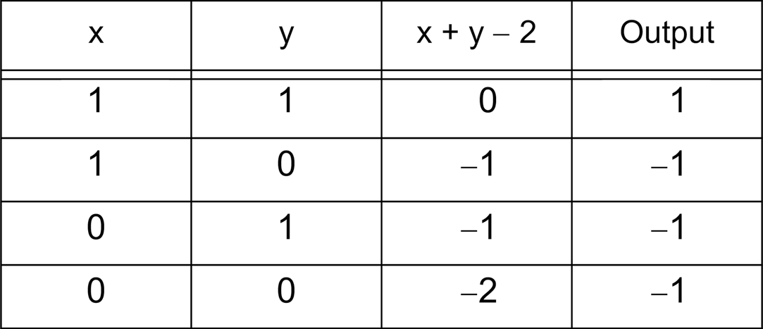
Example

Slide 9
Example
The neuron computes the values of x+y-2.
If this value is less than 0, it returns –1, otherwise a 1.
The logical OR function can be similarly computed by changing the bias weight to -1

Slide 10
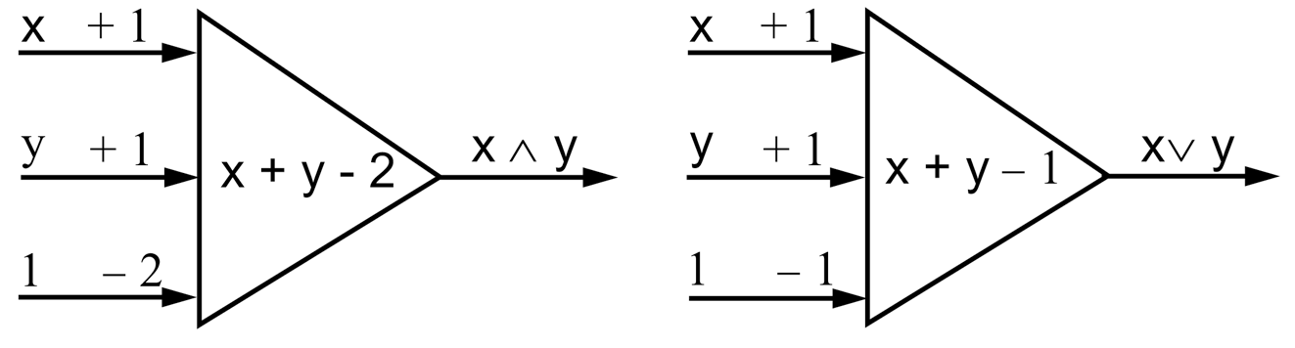
Example

Slide 11







Perceptron
Perceptron consists of two layers of neurons
$$y$$
$$w_{3}$$
$$θ$$
Output layer
$$w_{1}$$
$$w_{2}$$
Input layer
$$x_{1}$$
$$x_{2}$$

Slide 12
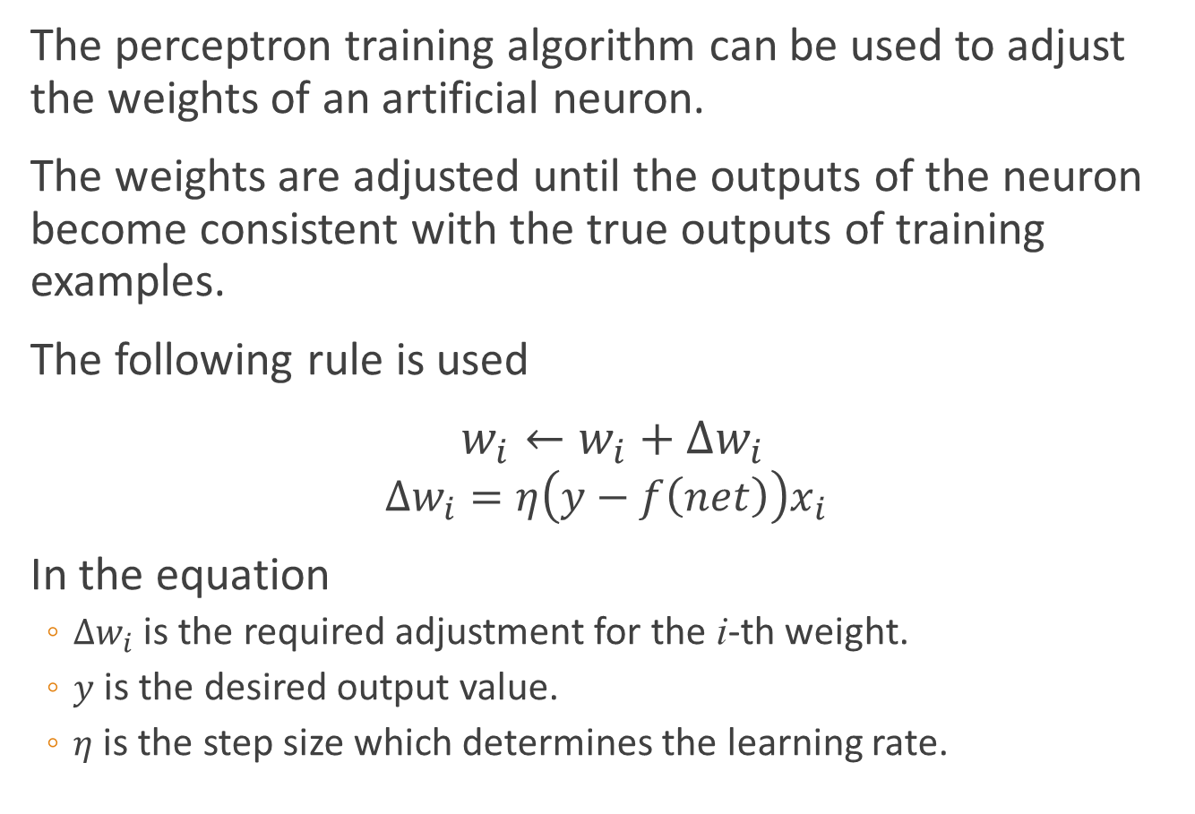
Perceptron
The perceptron training algorithm can be used to adjust the weights of an artificial neuron.
The weights are adjusted until the outputs of the neuron become consistent with the true outputs of training examples.
The following rule is used
$w_{i}←w_{i}+∆w_{i}$
$$∆w_{i}=η\left(y−f\left(net\right)\right)x_{i}$$
In the equation
  $∆w_{i}$ is the required adjustment for the i-th weight.
  $y$ is the desired output value.
  $η$ is the step size which determines the learning rate.

Slide 13
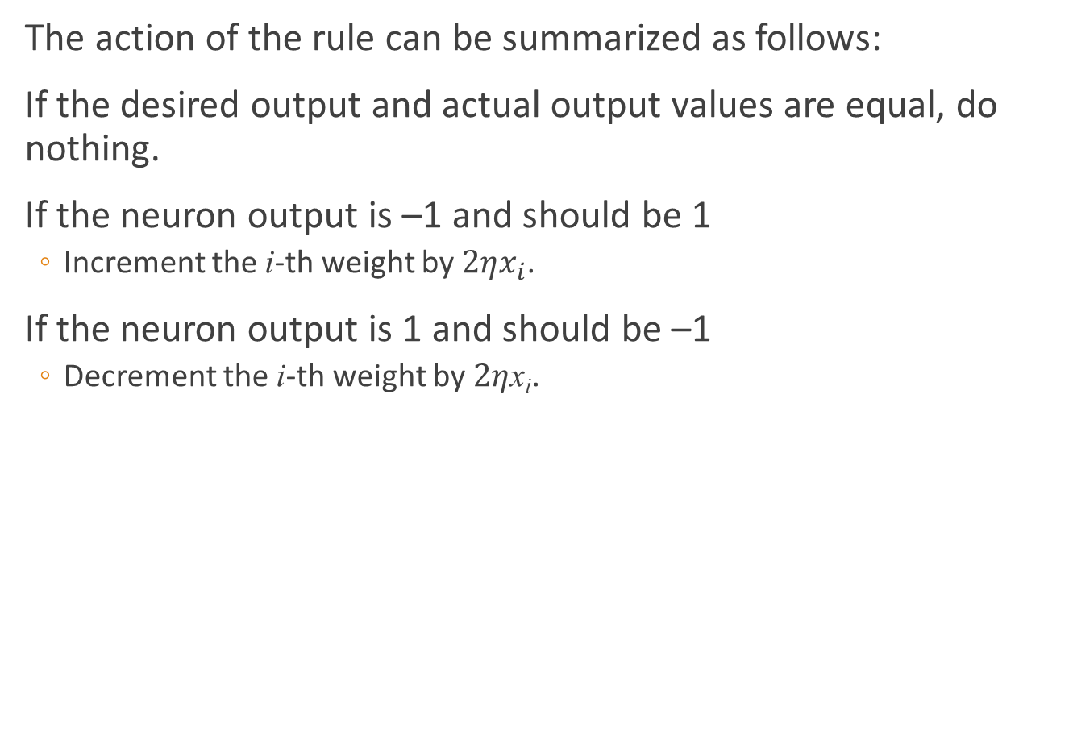
Perceptron
The action of the rule can be summarized as follows:
If the desired output and actual output values are equal, do nothing.
If the neuron output is –1 and should be 1
  Increment the i-th weight by $2ηx_{i}$.
If the neuron output is 1 and should be –1
  Decrement the i-th weight by $2η$x_{i}.

Slide 14
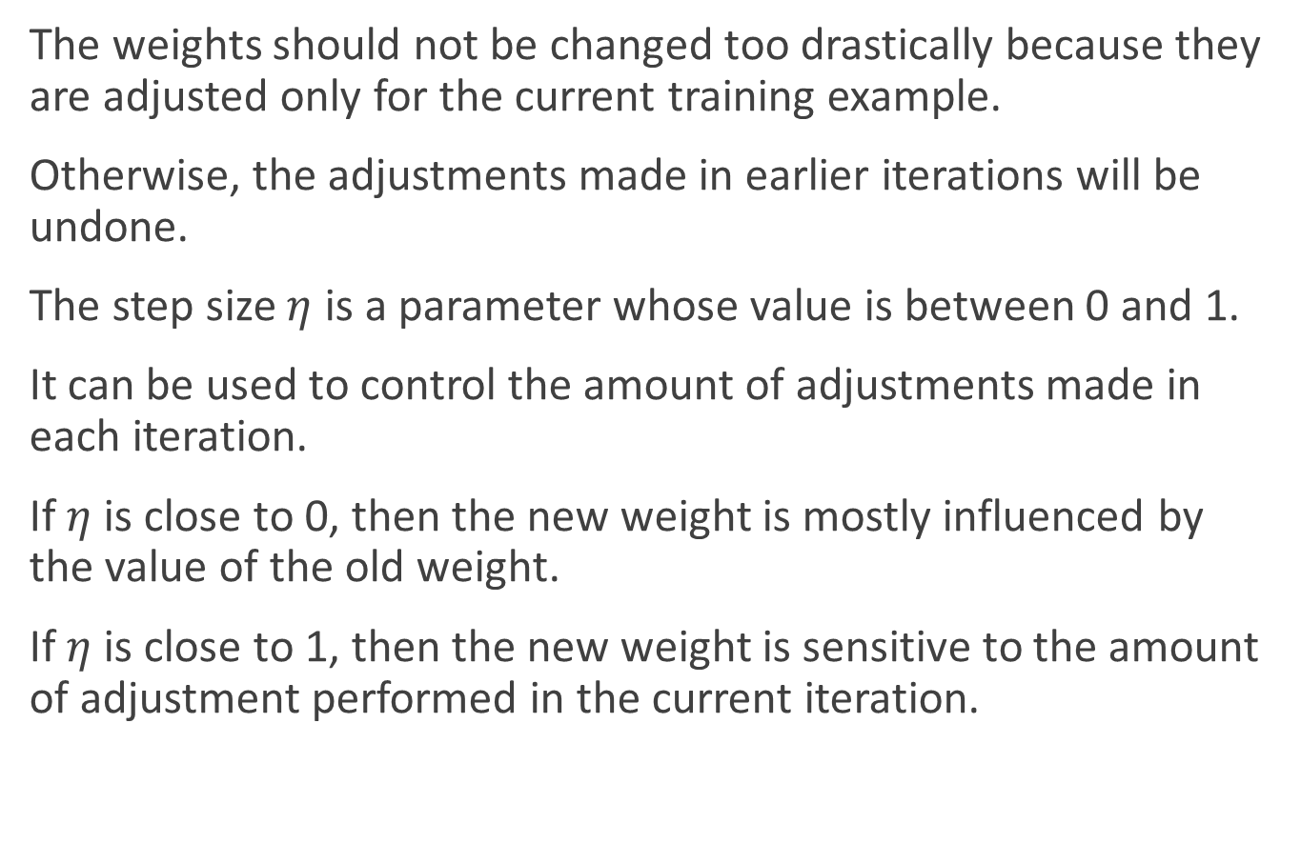
Perceptron
The weights should not be changed too drastically because they are adjusted only for the current training example.
Otherwise, the adjustments made in earlier iterations will be undone.
The step size $η$ is a parameter whose value is between 0 and 1.
It can be used to control the amount of adjustments made in each iteration.
If $η$ is close to 0, then the new weight is mostly influenced by the value of the old weight.
If $η$ is close to 1, then the new weight is sensitive to the amount of adjustment performed in the current iteration.

Slide 15

Perceptron
In some cases, an adaptive $η$ value can be used
  Initially, $η$ is moderately large during the first few iterations.
  It then gradually decreases in subsequent iterations.

Slide 16
Example
A set of patterns are to be classified in a 2-D space.
The first two columns of the table list the 2-D coordinates of the patterns.
The third column represents the classification, +1 or – 1.
The patterns are linearly separable, i.e., they can be completely separated by a hyperplane.

Slide 17
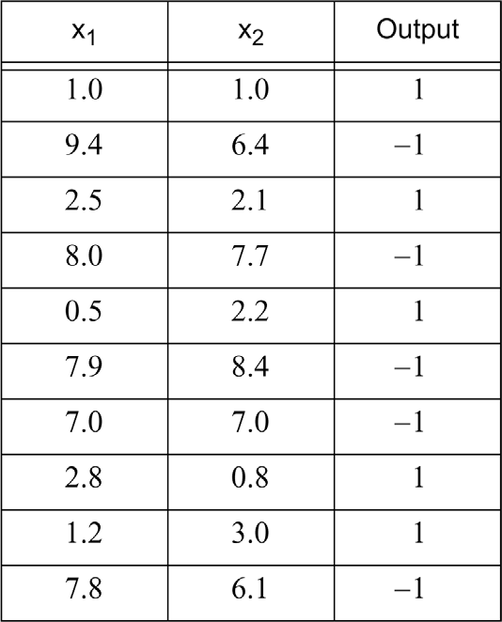
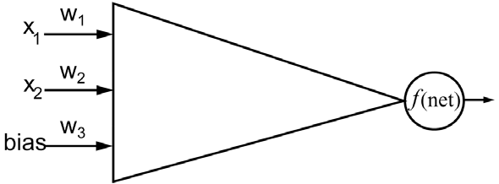
Example

Slide 18
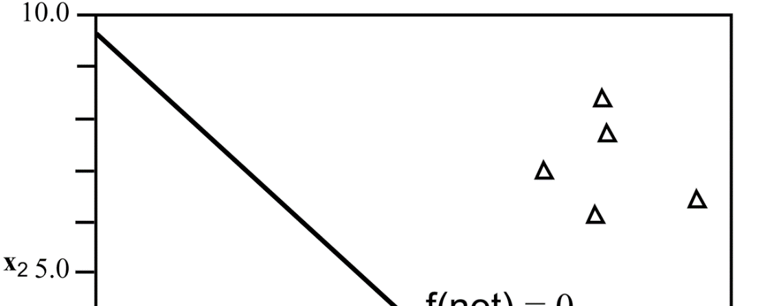
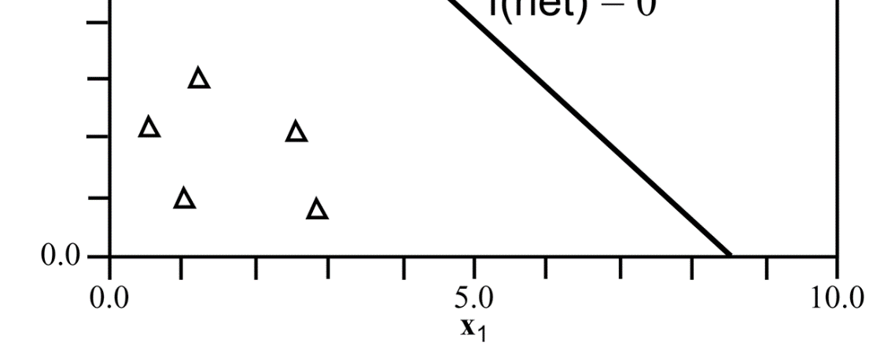
Example

Slide 19
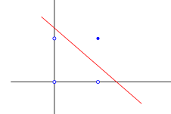
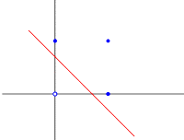
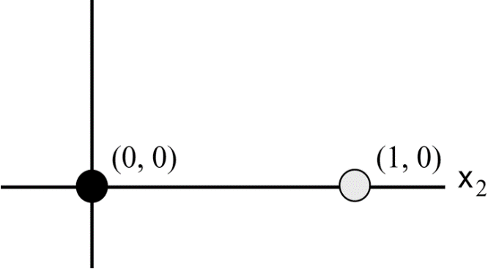
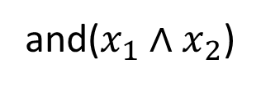
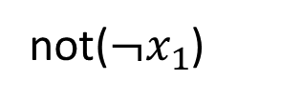
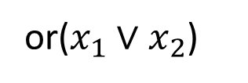
Exclusive-OR
Perceptron cannot solve those problems where the patterns are not linearly separable
An example of this is the exclusive-OR problem.
Multilayer networks are required for solving such kinds of problems.
+
-
and($x_{1}∧x_{2}$)
or($x_{1}∨x_{2}$)
not($¬x_{1}$)

Slide 20
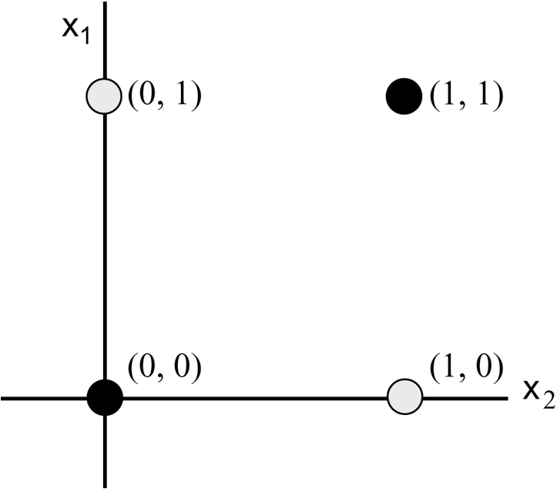
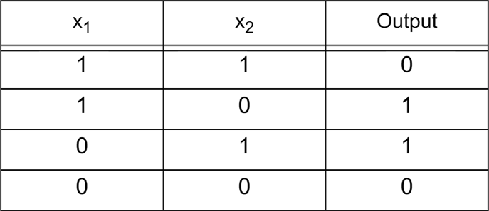
















Exclusive-OR
-
+
-
$$−0.5$$
$$y$$
$$1$$
$$−2$$
$$1$$
$$−1.5$$
$$−0.5$$
$$1$$
$$1$$
$$1$$
$$1$$
$$1$$
$$1$$
$$x_{1}$$
$$x_{2}$$

Slide 21
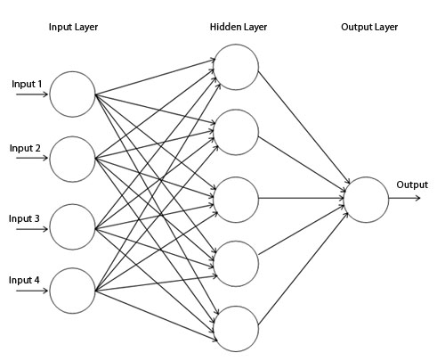
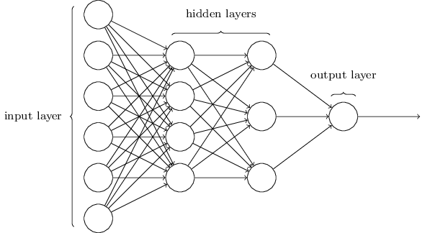
Multi-layer feedforward neural network
The additional layers between the input and output nodes are called hidden layers.
The nodes embedded in these layers are called hidden nodes.
We focus on feedforward neural networks, in which the nodes in one layer are connected only to the nodes in the next layer.

Slide 22
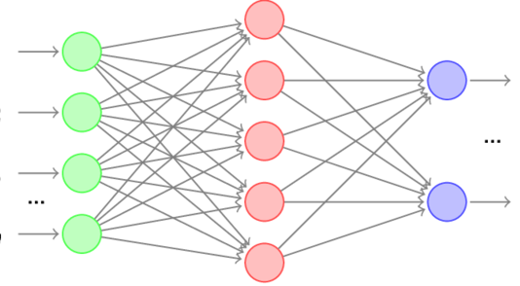
Backpropagation learning
The backpropagation learning algorithm is specifically designed for neural networks with multiple layers.
There are two phases in each iteration of the training algorithm
  The forward phase
  The backward phase

Slide 23
Backpropagation learning
During the forward phase, the weights obtained from the previous iteration are used to compute the output value of each neuron.
Outputs of the neurons at level l are computed prior to computing the outputs at level l+1.

Slide 24
Backpropagation learning
During the backward phase, the weight update equation is applied in the reverse direction.
In other words, the weights at level l+1 are updated before the weights at level l are updated.
The learning algorithm allows us to use the errors for neurons at layer l+1 to estimate the errors for neurons at layer l.

Slide 25
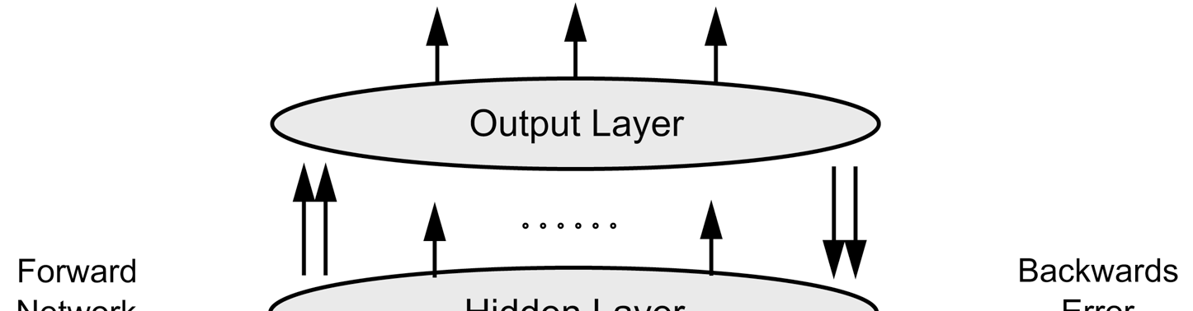
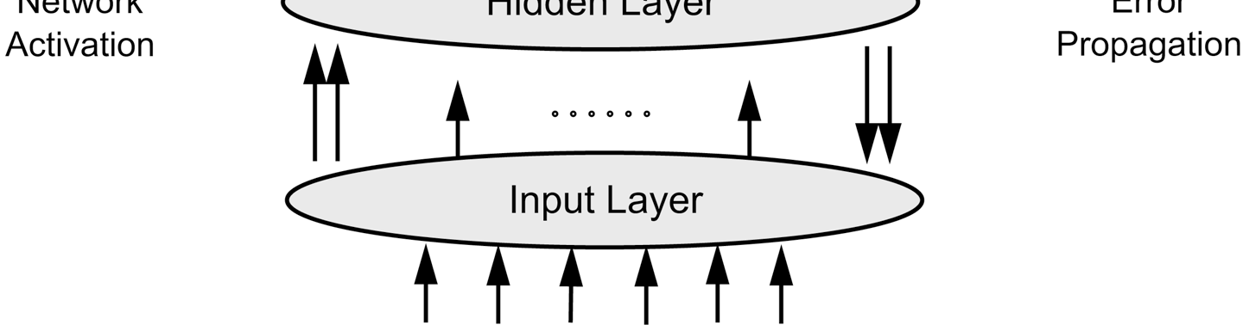
Backpropagation learning

Slide 26
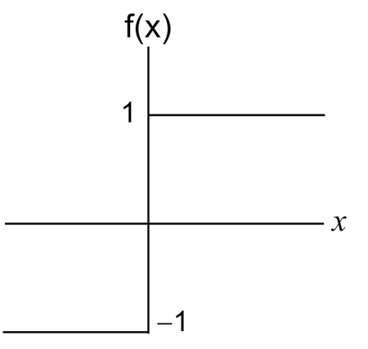
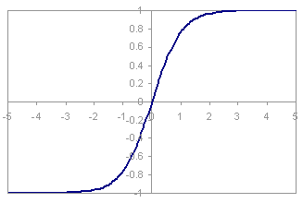


Backpropagation learning
The nodes in the network may use types of activation functions other than $sgn(x)$ function.
$$f(x)$$

Slide 27

Backpropagation learning
A common activation function is the sigmoid function
$$f\left(z\right)=\frac{1}{1+e^{−z}}$$
An important property of logistic function is that it is differentiable
$$f^{′}\left(z\right)=f\left(z\right)\left(1−f\left(z\right)\right)$$

Slide 28






















Backpropagation learning
$$β_{j}=\sum_{h=1}^{q}{w_{hj}}b_{h}$$
output layer
$$y_{1}$$
$$y_{2}$$
……
$$y_{j}$$
……
$$y_{l}$$
$$w_{1j}$$
$$w_{2j}$$
$$w_{hj}$$
$$w_{qj}$$
hidden layer
$$b_{1}$$
$$b_{2}$$
……
$$b_{h}$$
……
$$b_{q}$$
$$v_{1h}$$
$$v_{2h}$$
$$v_{ih}$$
$$v_{dh}$$
input layer
$$x_{1}$$
$$x_{2}$$
……
$$x_{i}$$
……
$$x_{d}$$
$$α_{h}=\sum_{i=1}^{d}{v_{ih}}x_{i}$$

Slide 29
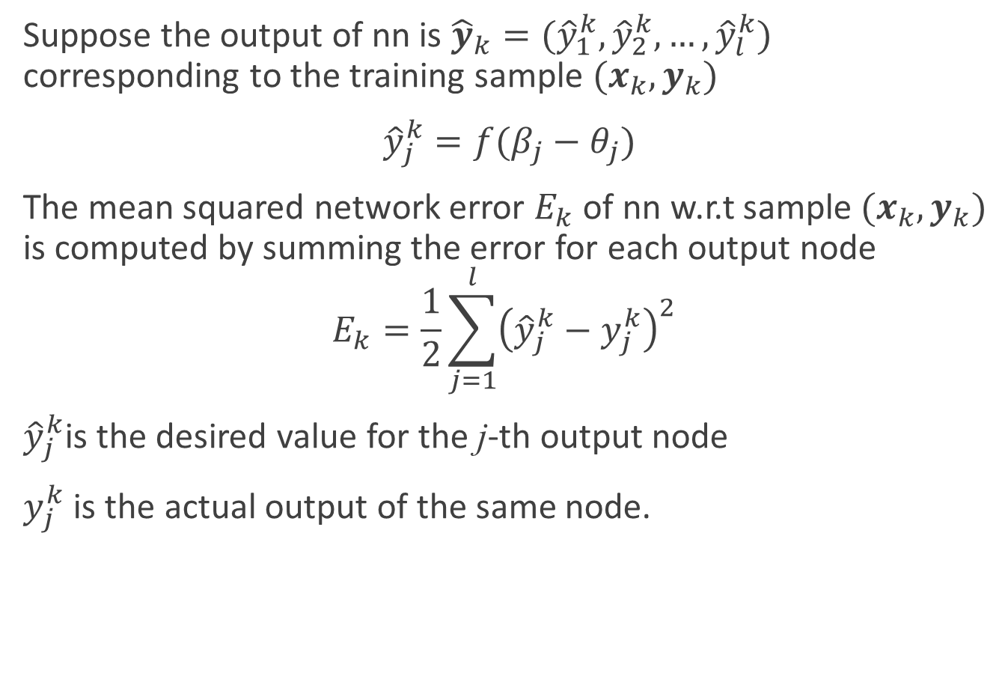
Backpropagation learning
Suppose the output of nn is ${\hat{y}}_{k}=({\hat{y}}_{1}^{k},{\hat{y}}_{2}^{k},…,{\hat{y}}_{l}^{k})$ corresponding to the training sample $(x_{k},y_{k})$
${\hat{y}}_{j}^{k}=f(β_{j}−θ_{j})$
The mean squared network error $E_{k}$ of nn w.r.t sample $(x_{k},y_{k})$ is computed by summing the error for each output node
$$E_{k}=\frac{1}{2}\sum_{j=1}^{l}{{\left({\hat{y}}_{j}^{k}−y_{j}^{k}\right)}^{2}}$$
${\hat{y}}_{j}^{k}$is the desired value for the j-th output node
$y_{j}^{k}$ is the actual output of the same node.

Slide 30
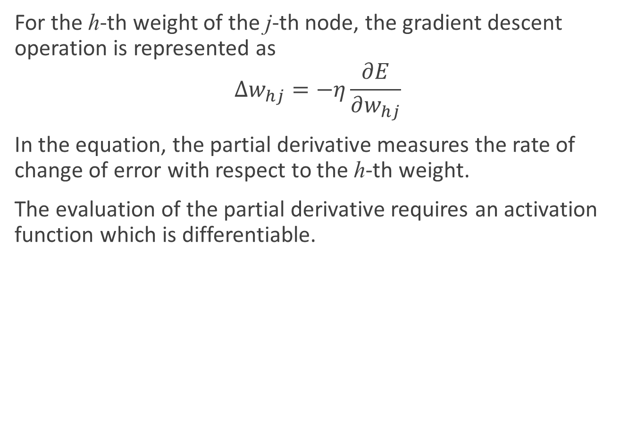
Backpropagation learning
For the h-th weight of the j-th node, the gradient descent operation is represented as
$$∆w_{hj}=−η\frac{∂E}{∂w_{hj}}$$
In the equation, the partial derivative measures the rate of change of error with respect to the h-th weight.
The evaluation of the partial derivative requires an activation function which is differentiable.

Slide 31
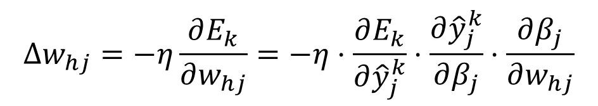

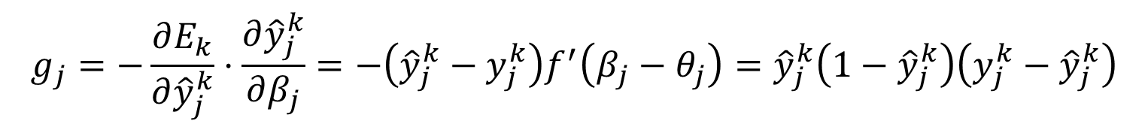

Backpropagation learning
Then we have
According to the definition of $β_{j}=\sum_{h=1}^{q}{w_{hj}}b_{h}$,
And $f^{′}\left(z\right)=f\left(z\right)\left(1−f\left(z\right)\right)$
$$∆w_{hj}=−η\frac{∂E_{k}}{∂w_{hj}}=−η⋅\frac{∂E_{k}}{∂{\hat{y}}_{j}^{k}}⋅\frac{∂{\hat{y}}_{j}^{k}}{∂β_{j}}⋅\frac{∂β_{j}}{∂w_{hj}}$$
$$\frac{∂β_{j}}{∂w_{hj}}=b_{h}$$
$$g_{j}=−\frac{∂E_{k}}{∂{\hat{y}}_{j}^{k}}⋅\frac{∂{\hat{y}}_{j}^{k}}{∂β_{j}}=−\left({\hat{y}}_{j}^{k}−y_{j}^{k}\right)f^{′}\left(β_{j}−θ_{j}\right)={\hat{y}}_{j}^{k}\left(1−{\hat{y}}_{j}^{k}\right)\left({y_{j}^{k}−\hat{y}}_{j}^{k}\right)$$

Slide 32
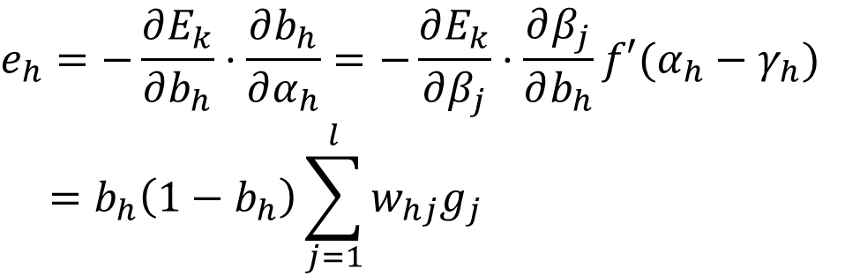

Backpropagation learning
Therefore,
$∆w_{hj}=ηg_{j}b_{h}$
Similarly, we can have
$∆θ_{j}=−ηg_{j}$
$∆v_{ih}=ηe_{h}x_{i}$
$∆γ_{h}=−ηe_{h}$
where
$$e_{h}=−\frac{∂E_{k}}{∂b_{h}}⋅\frac{∂b_{h}}{∂α_{h}}=−\frac{∂E_{k}}{∂β_{j}}⋅\frac{∂β_{j}}{∂b_{h}}f′(α_{h}−γ_{h})$$
$$=b_{h}\left(1−b_{h}\right)\sum_{j=1}^{l}{w_{hj}g_{j}}$$

Slide 33
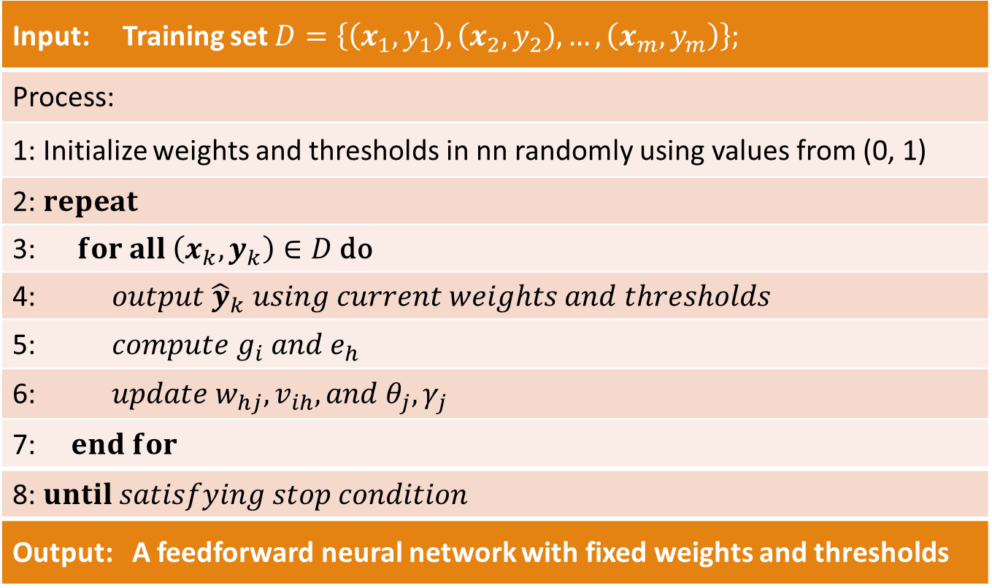
BP algorithm
Input: Training set $D=\left\{\left(x_{1},y_{1}\right),\left(x_{2},y_{2}\right),…,\left(x_{m},y_{m}\right)\right\};$
Process:
1: Initialize weights and thresholds in nn randomly using values from (0, 1)
2: $repeat$
3: $for all \left(x_{k},y_{k}\right)∈D \text{do}$
4: $output {\hat{y}}_{k} using current weights and thresholds$
5: $compute g_{i} and e_{h}$
6: $update w_{hj},v_{ih}, and θ_{j}, γ_{j}$
7: $end for$
8: $until satisfying stop condition$
Output: A feedforward neural network with fixed weights and thresholds

Slide 34
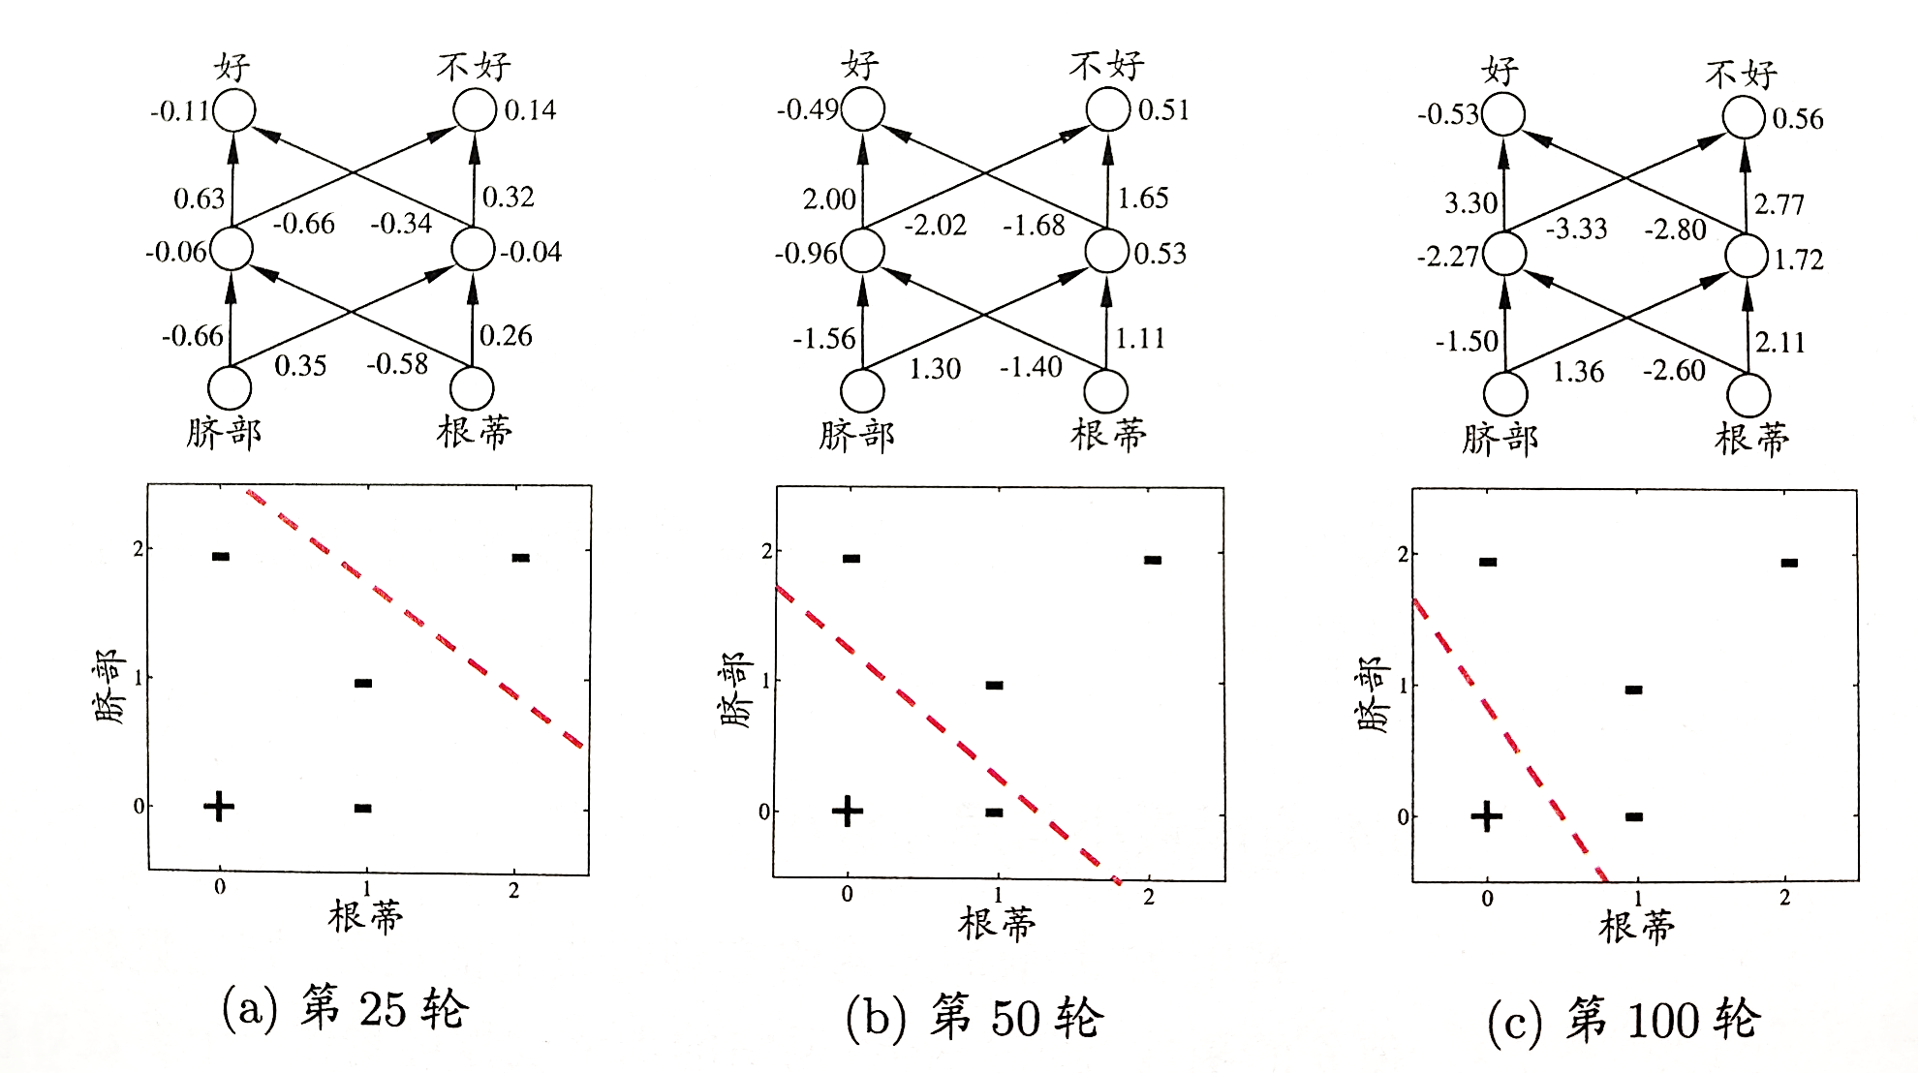
Backpropagation learning

Slide 35
Backpropagation learning
Backpropagation learning is based on the idea of an error surface.
The surface represents cumulative error over a data set as a function of network weights.
Each possible network weight configuration is represented by a point on the surface.

Slide 36
Backpropagation learning
The goal of the learning algorithm is to determine a set of weights that minimize the error.
The learning algorithm should be designed to find the direction on the surface which most rapidly reduces the error.
This can be achieved by moving in the opposite direction of the gradient vector at each surface point.
This approach is called gradient descent learning.

Slide 37
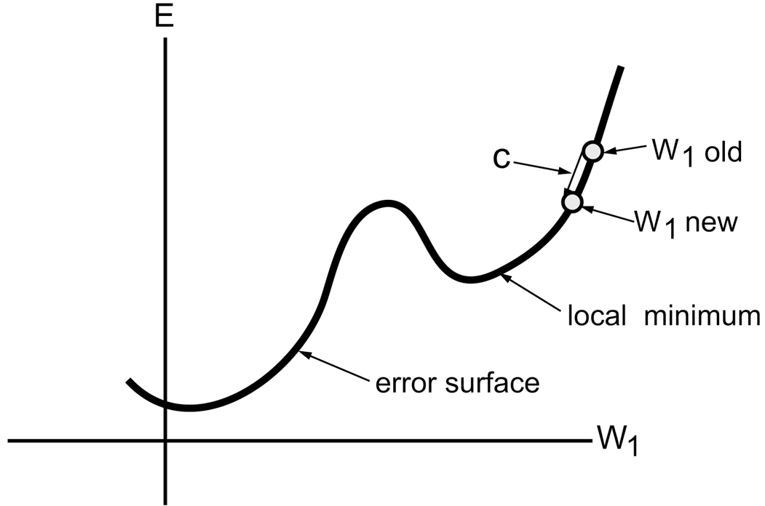
Backpropagation learning

Slide 38
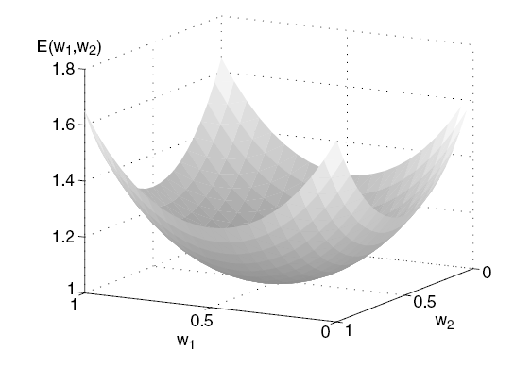
Backpropagation learning

Slide 39
Design issues
For a classification problem, if there are K possible classes
  Create one node for each possible class or
  Encode the class label using log₂K nodes.
A suitable network topology should be chosen
  We need to determine
    The number of hidden layers and
    The number of hidden nodes in each layer.
The weights need to be initialized
  Random assignments are usually acceptable.

Slide 40
Characteristics of neural networks
Multilayer neural networks with at least one hidden layer are universal approximators.
Neural networks can handle redundant features by reducing the values of the weights associated with these features.
The algorithm used for learning the weights of a neural networks sometimes converges to a local minimum.
Training a neural network is a time consuming process, especially when the number of hidden nodes is large.

Slide 41
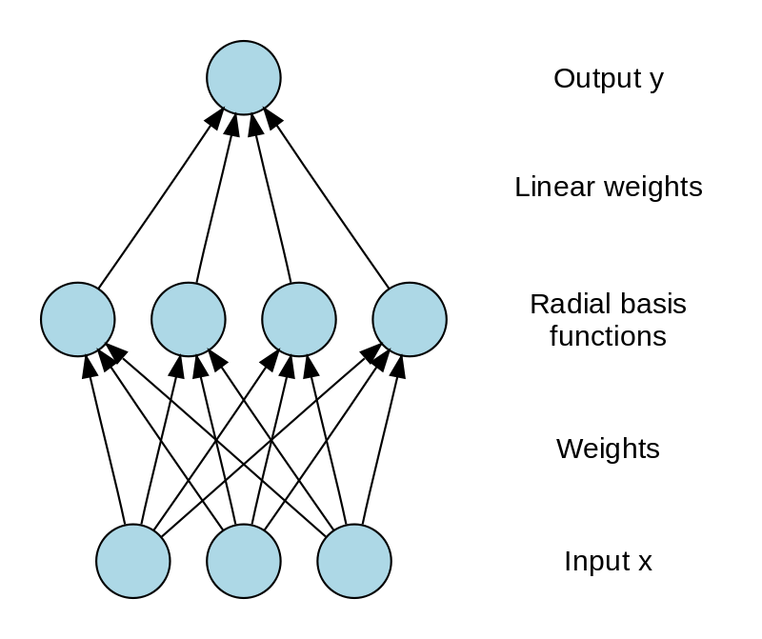


Other neural networks: RBF network
RBF (Radial Basis Function) network is an artificial neural network that uses radial basis functions as activation functions.
Radial basis function networks have many uses, including function approximation, time series prediction, classification, and system control.
$$φ\left(x\right)=\sum_{i=1}^{q}{w_{i}ρ(x,c_{i})}$$
$$ρ\left(x,c_{i}\right)={e^{−β_{i}\left\|x−c_{i}\right\|}}^{2}$$
The output of the network is a linear combination of radial basis functions of the inputs and neuron parameters.
Notes:
Functions that depend only on the distance from a center vector are radially symmetric about that vector, hence the name radial basis function.
Given certain mild conditions on the shape of the activation function, RBF networks are universal approximators on a compact subset of R^{n}. This means that an RBF network with enough hidden neurons can approximate any continuous function on a closed, bounded set with arbitrary precision.

Slide 42
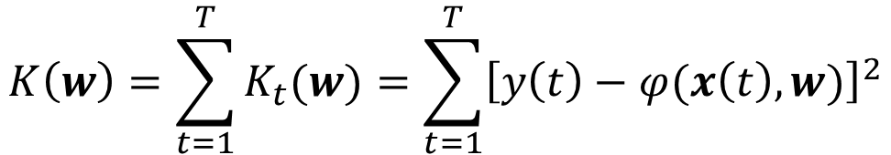

Other neural networks: RBF network
Training process:
Input: $x\left(t\right),y\left(t\right), t=1,…,T$
Step 1. The center vectors $c_{i}$ of the RBF functions in the hidden layer are chosen.
  Centers can be randomly sampled from some set of examples, or they can be determined using k-means clustering
Step 2. Fits a linear model with coefficients $w_{i}$ to the hidden layer’s outputs with respect to some objective function.
Step 3. An optional backpropagation step can be performed to fine-tune all of the RBF net's parameters.
$$K\left(w\right)=\sum_{t=1}^{T}{K_{t}(w)}=\sum_{t=1}^{T}{{\left[y\left(t\right)−φ(x\left(t\right),w)\right]}^{2}}$$

Slide 43




Other neural networks: RBF network
$$x\left(t+1\right)=f\left(x\left(t\right)\right)$$
$$≈φ\left(t\right)=φ\left(x\left(t\right)\right)$$
Example: Logistic map
$$φ\left(t\right)=\sum_{i=1}^{N}{w_{i}ρ(x,c_{i})}$$
$$=\sum_{i=1}^{N}{w_{i}{e^{−β_{i}\left\|x_{i}−c_{i}\right\|}}^{2}}$$
$$=\sum_{i=1}^{N}{w_{i}{e^{−β_{i}\left(x\left(t\right)−c_{i}\right)}}^{2}}$$
$$x\left(t+1\right)=f\left(x\left(t\right)\right)=4x\left(t\right)\left[1−x(t)\right]$$

Slide 44
Other neural networks: ART network
Competitive learning is a form of unsupervised learning in artificial neural networks, in which nodes compete for the right to respond to a subset of the input data.
There are three basic elements to a competitive learning rule:
  A set of neurons that are all the same except for some randomly distributed synaptic weights, and which therefore respond differently to a given set of input patterns
  A limit imposed on the "strength" of each neuron
  A mechanism that permits the neurons to compete for the right to respond to a given subset of inputs, such that only one output is active (i.e. "on") at a time. The neuron that wins the competition is called a "winner-take-all" neuron.

Slide 45
Other neural networks: ART network
Adaptive resonance theory (ART) is a theory on aspects of how the brain processes information.
The basic ART system is an unsupervised learning model.
It typically consists of a comparison field and a recognition field composed of neurons, a vigilance parameter (threshold of recognition), and a reset module.

Slide 46

Other neural networks: ART network

Slide 47
Other neural networks: ART network
The comparison field takes an input vector and transfers it to its best match in the recognition field.
Each recognition field neuron outputs a negative signal to each of the other recognition field neurons and thus inhibits their output.
After the input vector is classified, the reset module compares the strength of the recognition match to the vigilance parameter.
  If the vigilance parameter is overcome, the weights of the winning recognition neuron are adjusted towards the features of the input vector
  Otherwise, if the match level is below the vigilance parameter, the winning recognition neuron is inhibited and a search procedure is carried out
  If no committed recognition neuron's match overcomes the vigilance parameter, then an uncommitted neuron is committed and its weights are adjusted towards matching the input vector.

Slide 48
Other neural networks: ART network
Higher vigilance produces highly detailed memories (many, fine-grained categories), while lower vigilance results in more general memories (fewer, more-general categories).

Slide 49

Other neural networks: SOM network
A self-organizing map (SOM) network uses unsupervised learning to produce a low-dimensional (typically two-dimensional), discretized representation of the input space of the training samples
Self-organizing maps differ from other artificial neural networks as they apply competitive learning as opposed to error-correction learning

Slide 50

Other neural networks: SOM network

Slide 51


Other neural networks: RBM
Boltzmann Machine were first invented in 1985 by Geoffrey Hinton Its units produce binary results
$$E=−\left(\sum_{i=1}^{n−1}{\sum_{j=i+1}^{n}{w_{ij}s_{i}s_{j}}}+\sum_{i=1}^{n}{θ_{i}s_{i}}\right)$$
$w_{ij}$ is the connection strength between unit i and j
$s_{i}∈\left\{0,1\right\}$ is the state of unit i
$θ_{i}$ is the bias of unit i in the global energy function
Notes:
若网络中的神经元以任意不依赖于输入值的顺序进行更新，则网络最终将达到Boltzmann分布，此时状态向量s出现的概率仅由其能量与所有可能状态向量的能量确定

Slide 52

Other neural networks: RBM
Boltzmann Machine is a generative unsupervised models, which involve learning a probability distribution from an original dataset
Boltzmann Machine have an input layer (the visible layer) and one or several hidden layers
Boltzmann Machine is a fully connected network
The required time order to collect equilibrium statistics grows exponentially with the machine's size, and with the magnitude of the connection strengths
Notes:
Boltzmann机的训练过程就是将每个训练样本视为一个状态向量，使其出现的概率尽可能大。标准的Boltzmann机是一个全连接图，训练网络的复杂度很高，这使其难以用于解决现实任务
All these parameters together form a system, they all work together. All these parameters are binary.

Slide 53

Other neural networks: RBM
A restricted Boltzmann machine (RBM) is a generative stochastic artificial neural network that can learn a probability distribution over its set of inputs

Slide 54

Other neural networks: RBM
Training algorithm: Contrastive Divergence
Step 1. Take a training sample v, compute the probabilities of the hidden units and sample a hidden activation vector h from this probability distribution.
Step 2. Compute the outer product of v and h and call this the positive gradient.
Step 3. From h, sample a reconstruction v' of the visible units, then resample the hidden activations h' from this
Step 4. Compute the outer product of v' and h' and call this the negative gradient.
Step 5. Update to the weight matrix $ΔW=ε\left(vh^{T}−v^{′}h^{′T}\right)$

